Slide 1
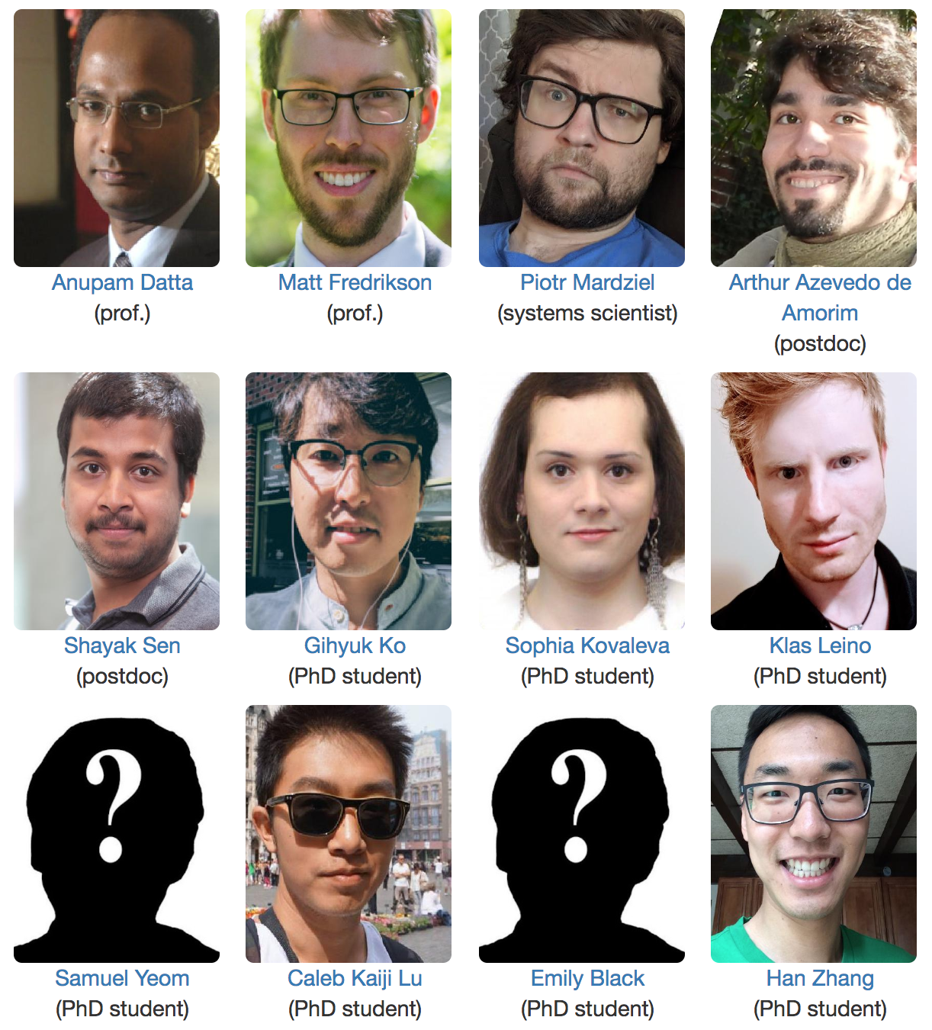

Accountable Deep Learning
Piotr (Peter) Mardziel
Accountable Systems Lab
fairlyaccountable.org
@ Silicon Valley (rest @ Pittsburgh)

Slide 2
Human Learning
Wordly observations
Concept / rule / idea

Slide 3
Human Learning
new specimen
Wolfs have narrower ears and ...
Huskies have ...
prediction
What physical characteristics distinguish wolves from huskies?

Slide 4
Machine learning
img1, wolf
new unlabeled photo
img2, wolf
Machine learning model
img10001, husky
img10002, husky
prediction
What physical characteristics distinguish wolves from huskies?

Slide 5
What can go wrong?
Bugs
Privacy
Failure of cyber-physical systems
Discrimination
Compliance with regulations
Machine learning model
husky
(wrong)

Slide 6
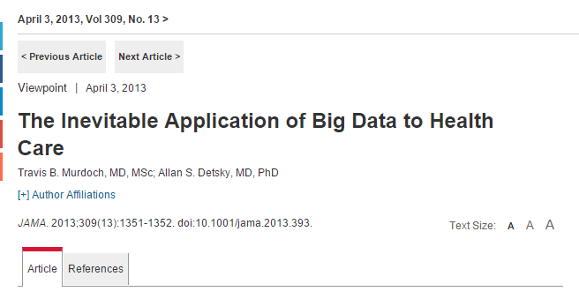
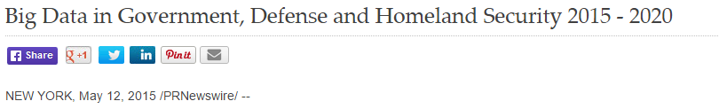
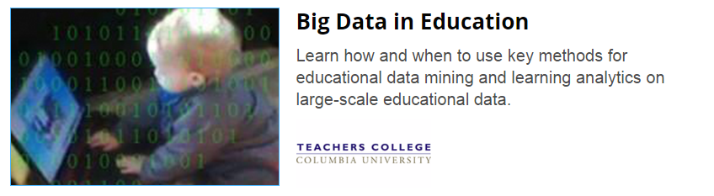
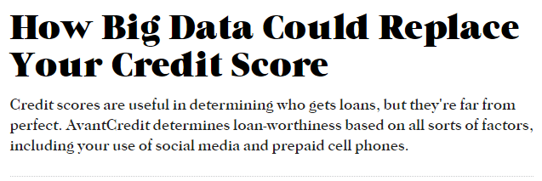
What can go wrong?
Notes:
Automated data-driven systems that employ machine learning and other artificial intelligence technologies increasingly make decisions that affect our lives.
Which loan or job applications should be approved? How likely is a criminal offender to commit another crime? Does a set of medical images indicate that an individual has cancer? Which advertisements and recommendations should be shown to people as they interact in the digital and physical world?

Slide 7
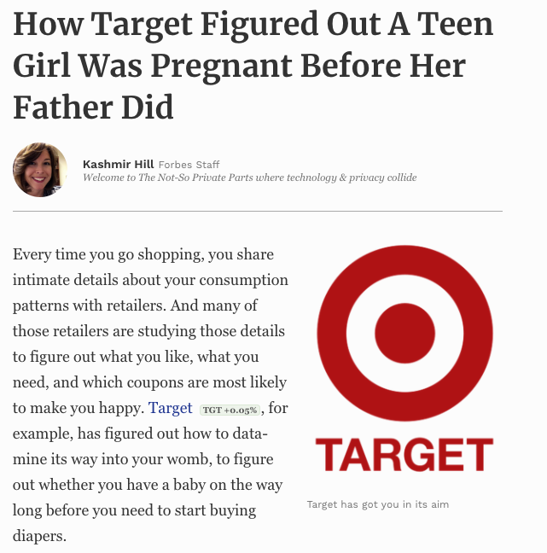
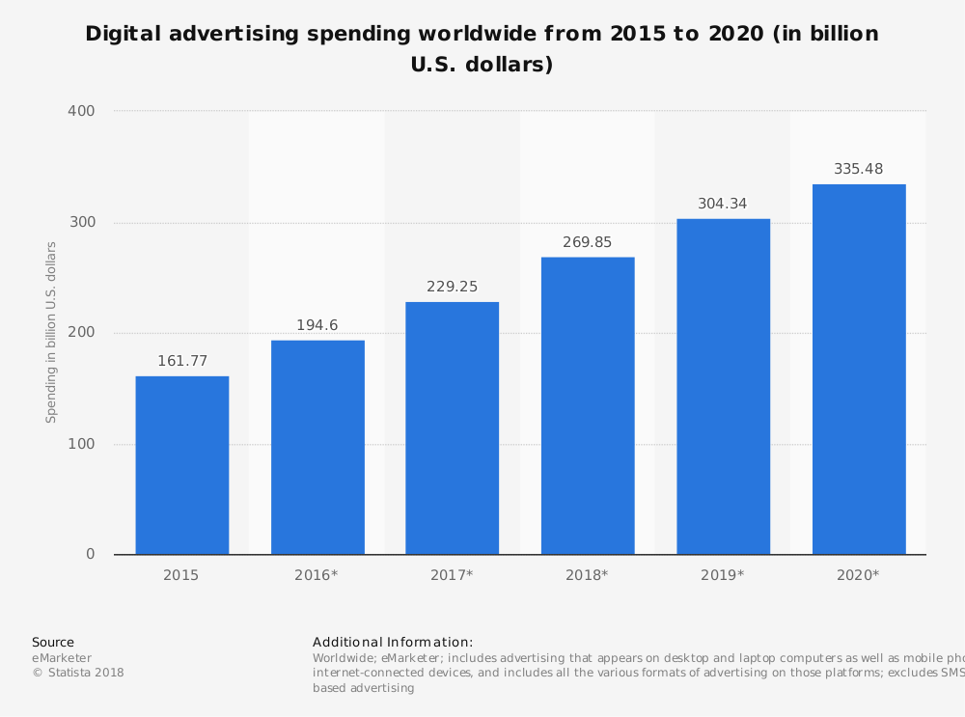
What can go wrong?
Digital advertising
Is privacy preserved?
Notes:
Automated data-driven systems that employ machine learning and other artificial intelligence technologies increasingly make decisions that affect our lives.
Which loan or job applications should be approved? How likely is a criminal offender to commit another crime? Does a set of medical images indicate that an individual has cancer? Which advertisements and recommendations should be shown to people as they interact in the digital and physical world?

Slide 8
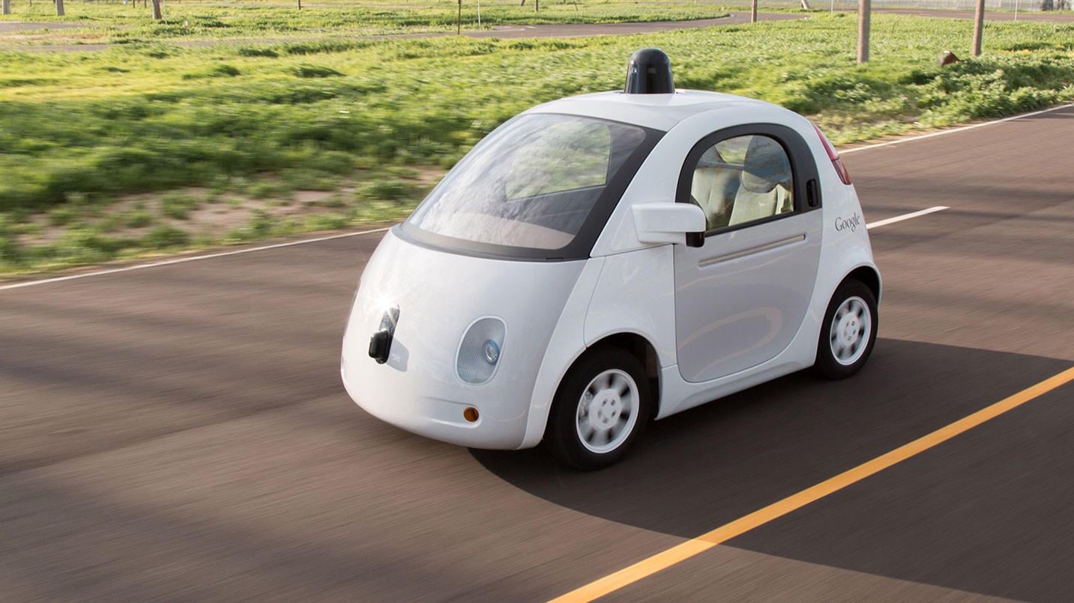

What can go wrong?
Cyber physical systems
(speed limit sign)
Am I going to die in a traffic accident?
Notes:
Automated data-driven systems that employ machine learning and other artificial intelligence technologies increasingly make decisions that affect our lives.
Which loan or job applications should be approved? How likely is a criminal offender to commit another crime? Does a set of medical images indicate that an individual has cancer? Which advertisements and recommendations should be shown to people as they interact in the digital and physical world?

Slide 9
What can go wrong?
Bugs
Privacy
Failure of cyber-physical systems
Discrimination
Compliance with regulations

Slide 10
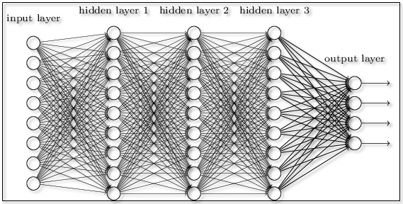
Deep Learning
Well suited for problems with large number of inputs
Natural language processing
speech recognition
translation
Vision
object classification
self driving cars
millions of
pixels
thousands
of samples

Slide 11
Deep Learning
Not well suited for understanding/interpretability.

Slide 12
Ongoing Projects
Project 1: Debiasing neural natural language processing systems
Project 2: Conditional debiasing in neural networks
Project 3: Explaining neural networks
other projects with and without deep learning

Slide 13
Project 1: Debiasing NLP [Lu, Wu^, Amancharla^, Mardziel, Datta]
Biases in NLP systems.
“Man is to programmer as woman is to homemaker”*
NLP Task 1: Coreference resolution.
“The doctor was late because he was in traffic”.
“The doctor was late because she was in traffic”.
NLP Task 2: Language modeling.
“He is a doctor”.
“She is a doctor”.
^ Masters students
* Bolukbasi et al. 2016

Slide 14

Project 1: Debiasing NLP
corpus
???
Biased
NLP model
???

Slide 15

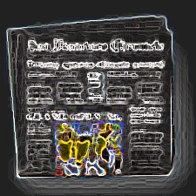
Project 1: Debiasing NLP
corpus
???
Biased
NLP model
???
augmented corpus
Unbiased
NLP model
???

Slide 16
Project 2: Conditional debiasing [Kovaleva, Mardziel, Datta]
Law (USA): Age cannot be used to make credit decisions.
Solution: do not include age in your machine learning methods.

Slide 17
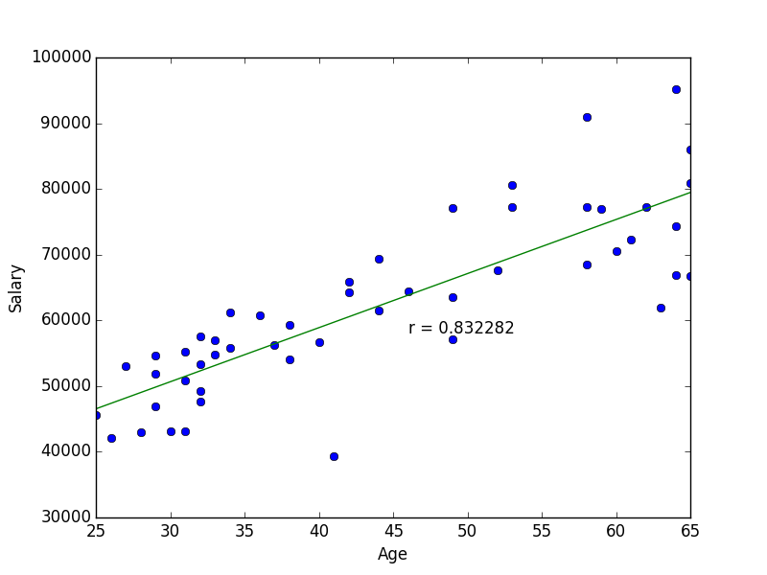
Project 2: Conditional debiasing [Kovaleva, Mardziel, Datta]
Law (USA): Age cannot be used to make credit decisions.
Solution: do not include age in your machine learning methods.
Problem: age can be used even if it is not explicitly an input.
Can be inferred from explicit inputs.

Slide 18
Project 2: Conditional debiasing [Kovaleva, Mardziel, Datta]
Law (USA): Age cannot be used to make credit decisions.
Except when justified by business necessity.
⨯
✔

Slide 19
Project 2: Conditional debiasing [Kovaleva, Mardziel, Datta]
Our approach
Express violation as continuous (differentiable) function
Include minimization of violation in the learning process
⨯
✔

Slide 20
Project 3: Explaining deep networks [Leino, Sen, Li, Datta, Fredrikson]
Influence measurement:
How influential is an input on the output of a model?
input 1
output

Slide 21
Project 3: Explaining deep networks [Leino, Sen, Li, Datta, Fredrikson]
Influence measurement:
How influential is an input on the output of a model?
Problem: too many, uninterpretable, inputs (pixels, samples, etc.)
a single pixel
wolf
husky

Slide 22
Project 3: Explaining deep networks [Leino, Sen, Li, Datta, Fredrikson]
Approach:
Identify causally influential neurons in internal layers
Give them interpretation using visualization techniques
wolf
husky

Slide 23
Project 3: Why classified as sports car instead of convertible?
VGG16 ImageNet model
Input image
Influence-directed Explanation
Uncovers high-level concepts that generalize across input instances
Notes:
Images of cars labeled “sports car” by VGG16 ImageNet
model (a) and receptive fields of the most influential feature map
on a comparative quantity that characterizes the model’s tendency
to predict “sports car” over “convertible” (b). In most cases, the
features within the field contain the top of the car, which is the key
distinctive concept between these classes.

Slide 24
What can go wrong?
Bugs
Privacy
Failure of cyber-physical systems
Discrimination
Compliance with regulations
snow
Ribeiro et al. 2016
Machine learning model
husky
(wrong)

Slide 25
Vision: Explainable Machine Learning Systems
Reveal “meaningful information about the logic” of the machine learnt prediction/decision model
Enable humans + machines to make better decisions together
Build trust in and debug models
Guard against societal harms, e.g. unfairness
Comply with regulations , e.g. EU GDPR, US ECOA
Applications: Finance, healthcare, security, cyber-physical systems

Slide 26

Project 1: Debiasing neural natural language processing systems
Project 2: Conditional debiasing in neural networks
Project 3: Explaining neural networks
other projects with and without deep learning
Piotr (Peter): piotrm@cmu.edu
Anupam: danupam@cmu.edu
Accountable Systems Lab
fairlyaccountable.org
@ Silicon Valley (rest @ Pittsburgh)

